Slide 1
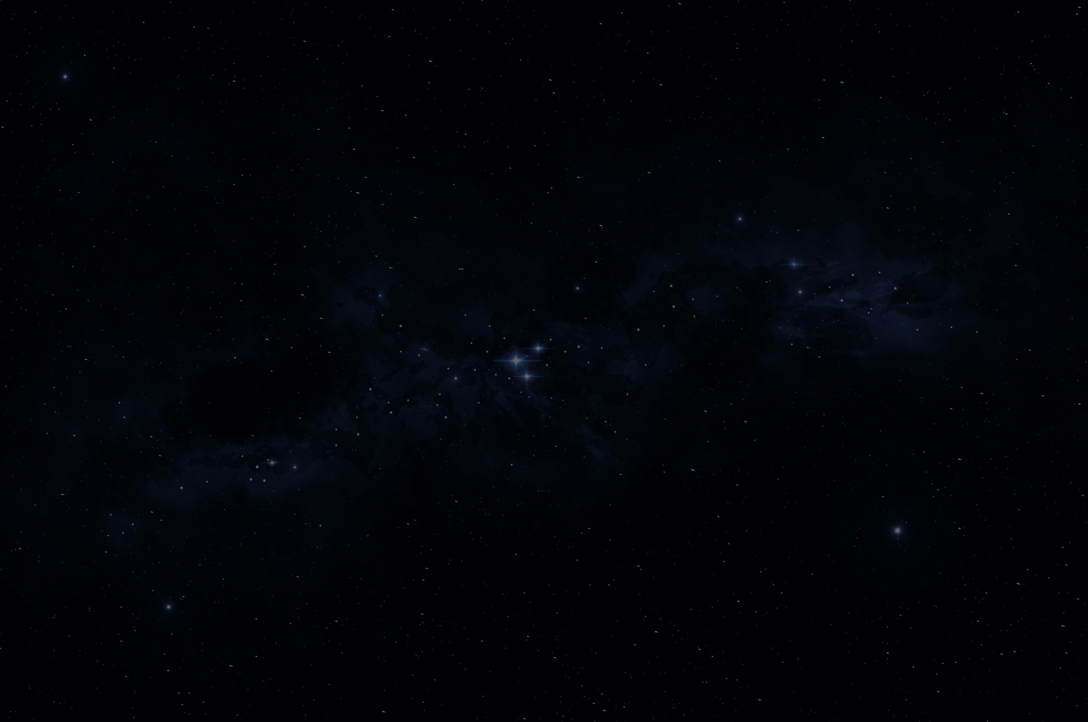

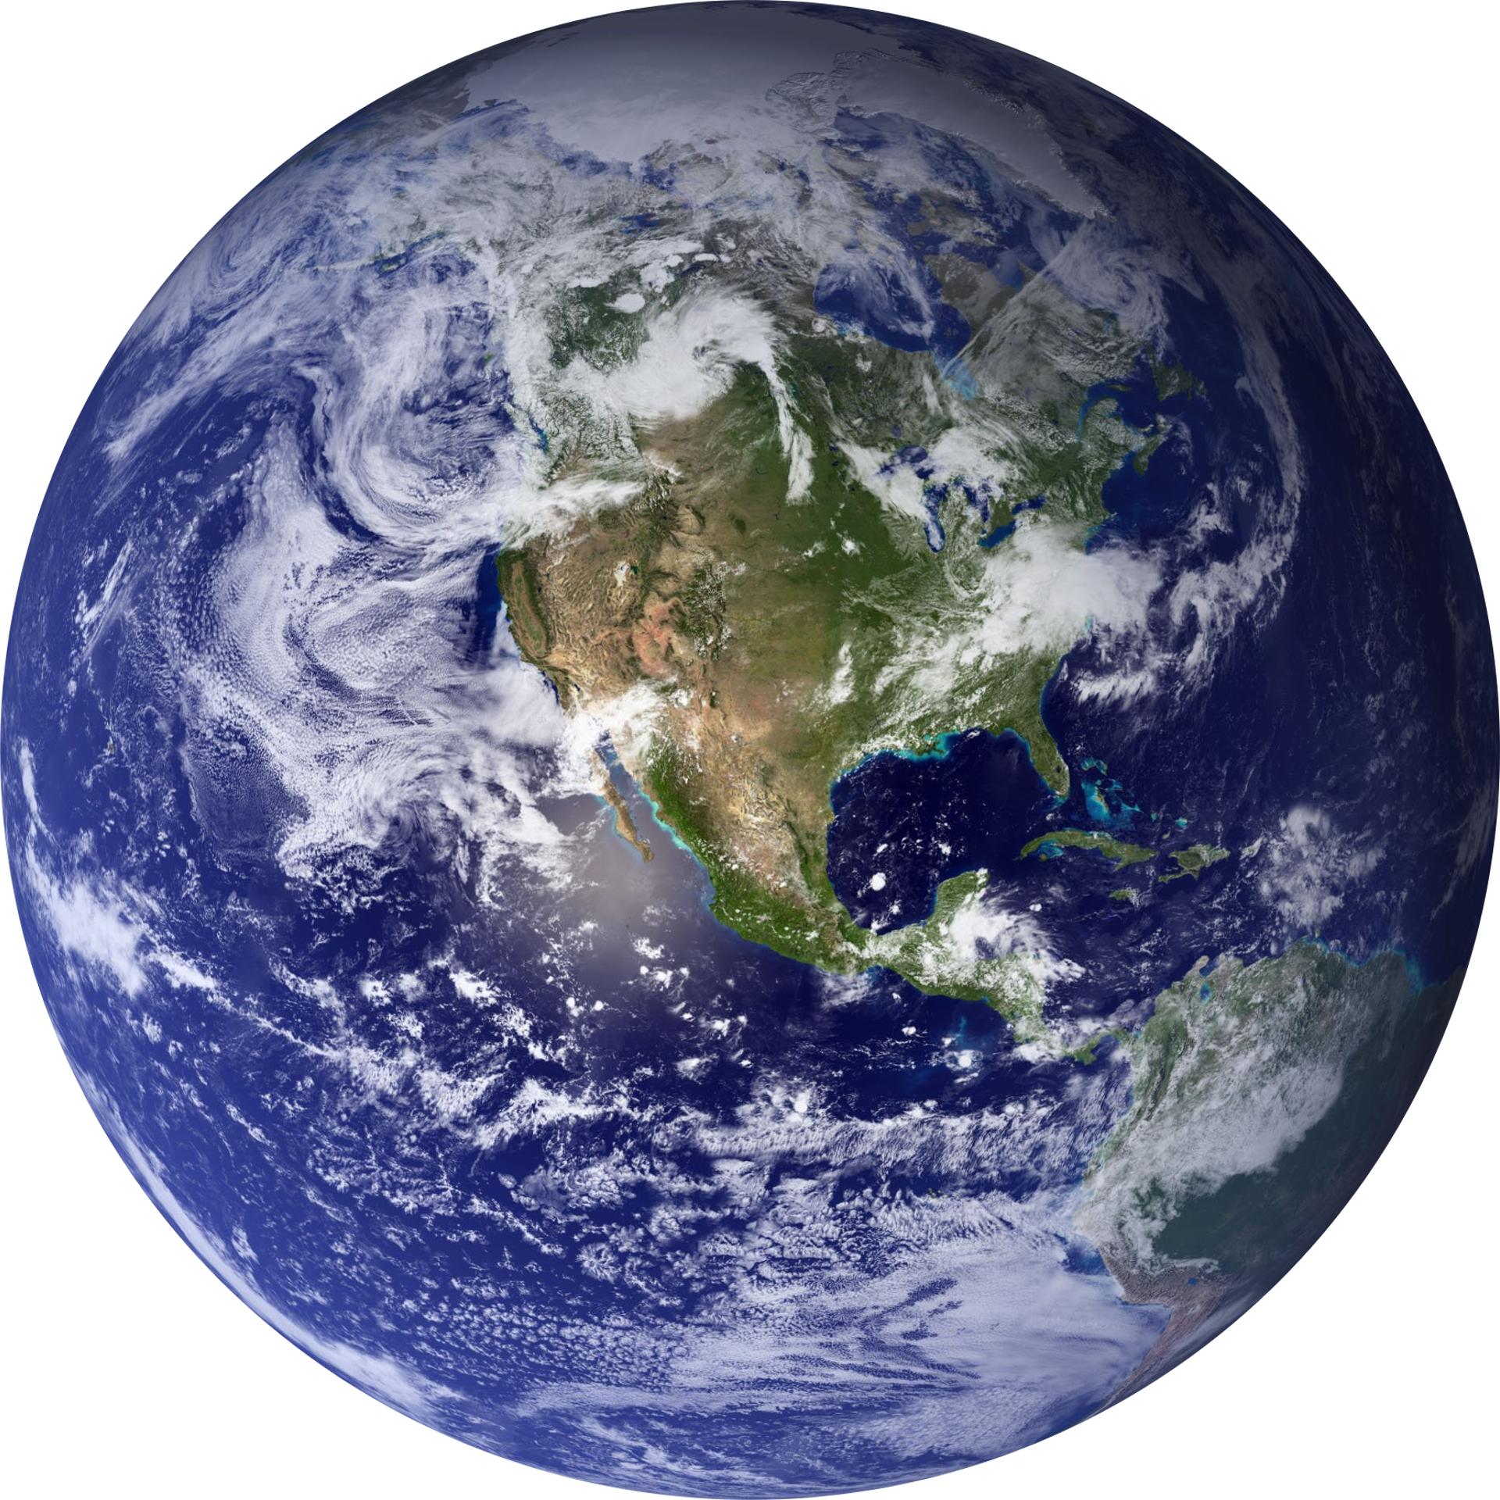

ENVIROSCAN
AI-POWERED POLLUTION SOURCE IDENTIFIER USING GEOSPATIAL ANALYTICS
Shreya N Gowda
Computer Science & Engineering
Jain Institute of Technology

Slide 2
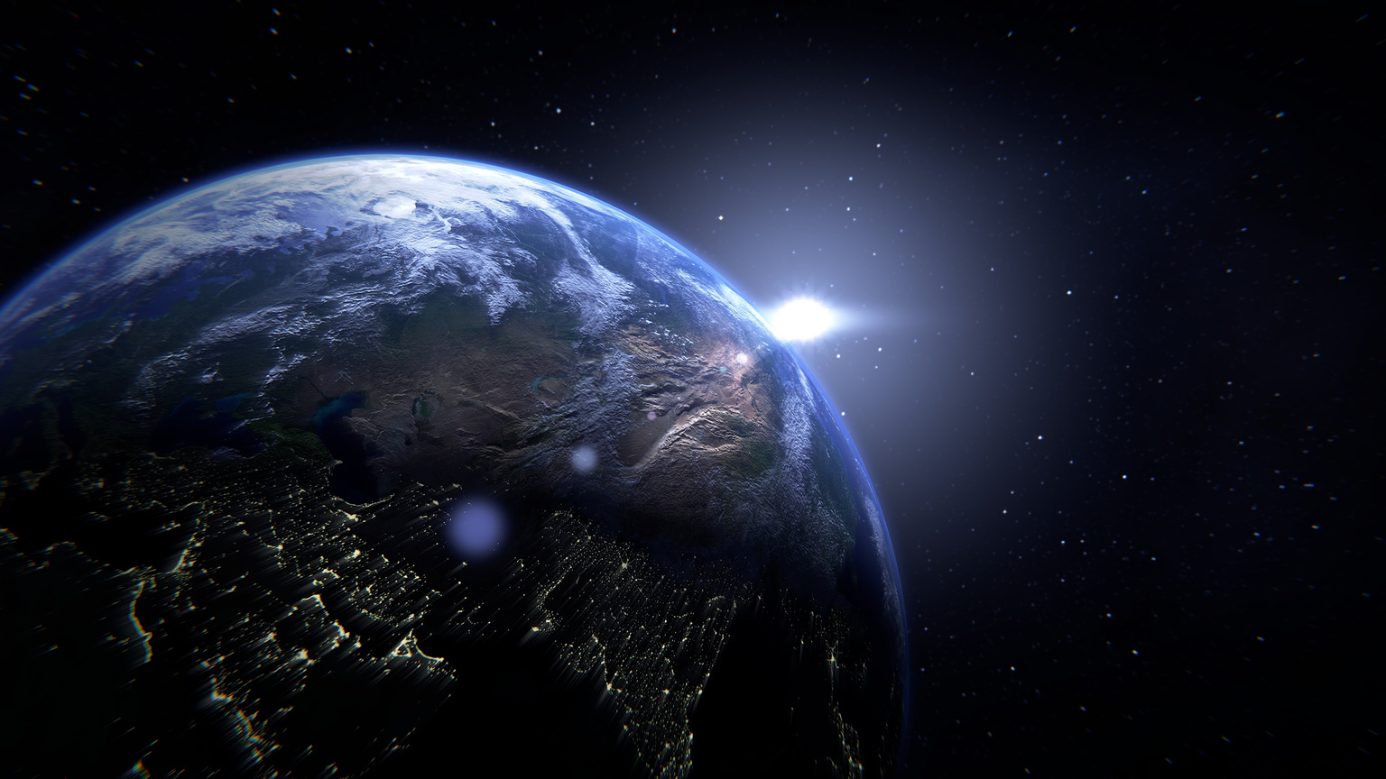
Abstract
•Air pollution is a serious environmental challenge
•Existing systems lack pollution source identification
•EnviroScan applies AI and geospatial analytics
•Interactive visualization through a dashboard

Slide 3
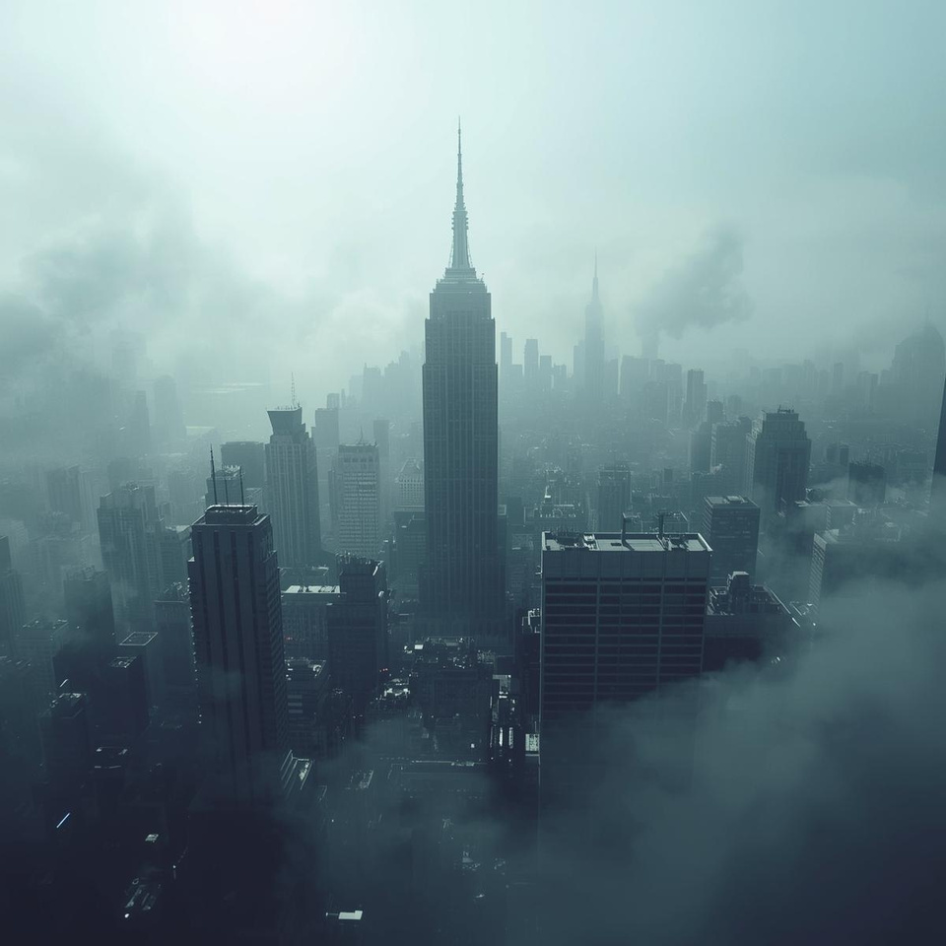
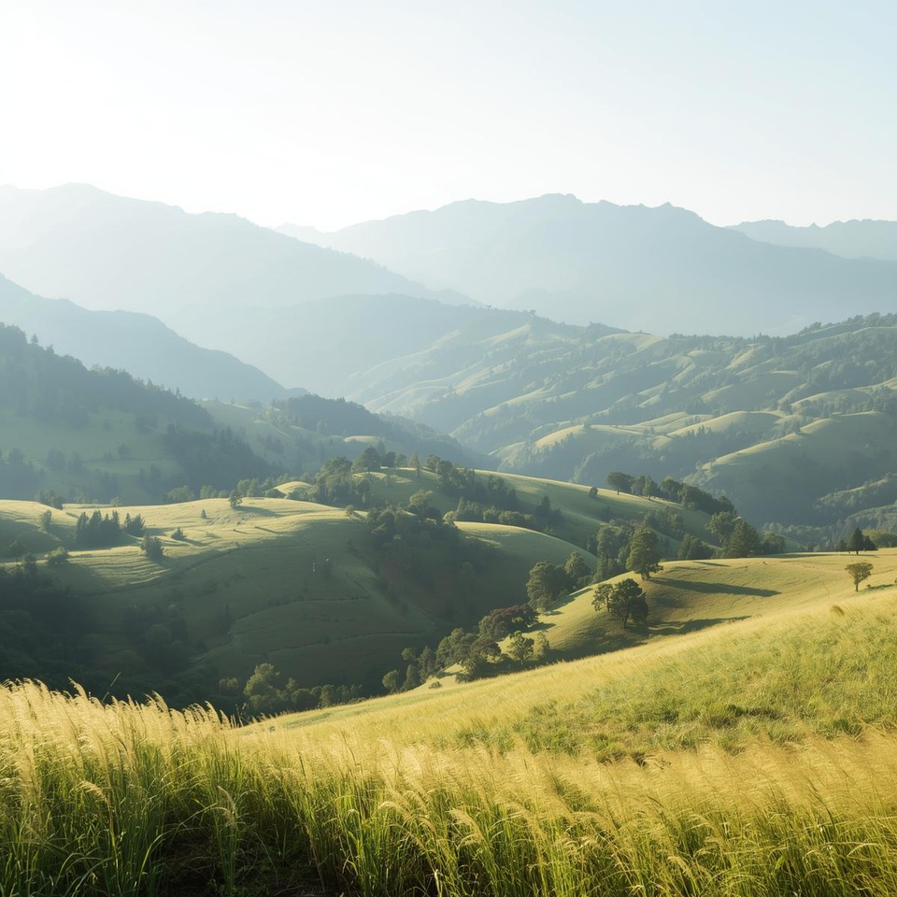
Introdution
Rapid urbanization and industrialization have significantly increased air pollution levels in many cities. EnviroScan aims to bridge this gap by combining machine learning and geospatial analysis to automatically classify pollution sources and visualize them through an interactive dashboard.

Slide 4

Problem Statement
Existing air-quality systems only report pollutant concentrations
Pollution source identification is largely manual
Lack of real-time visual analytics
Limited decision-support tools for policymakers
To design an automated system that identifies pollution sources from air-quality data and presents insights through an interactive dashboard.

Slide 5
System Architecture
OpenAQ API
↓
Data Collection
↓
Preprocessing
↓
Feature Engineering
↓
Machine Learning Model
↓
Source Prediction
↓
Streamlit Dashboard

Slide 6
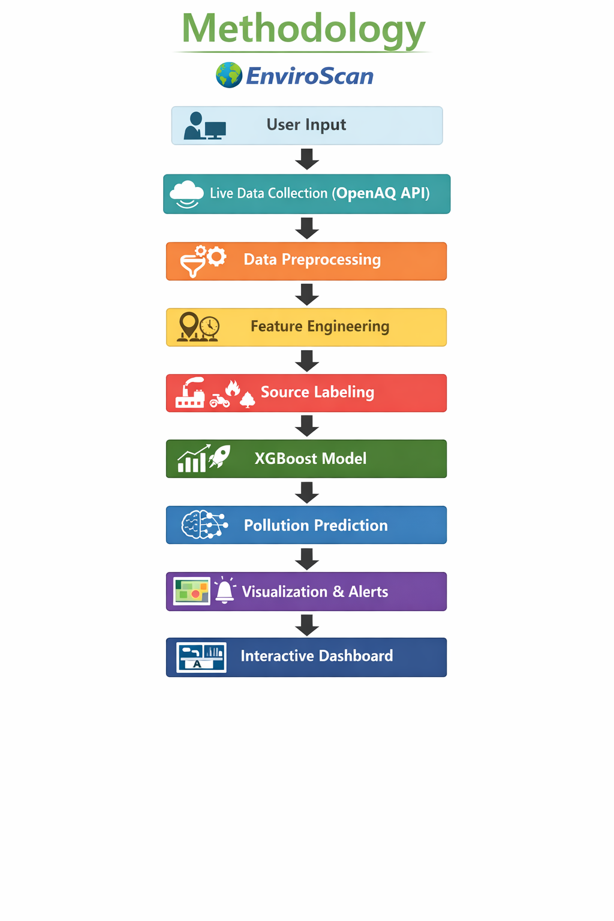
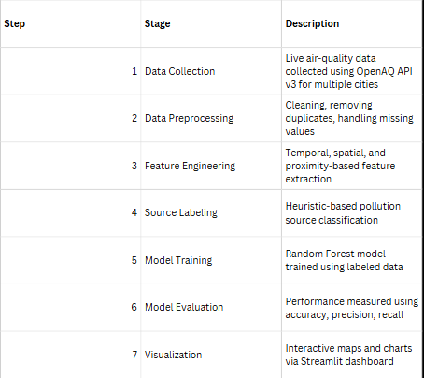
Methodology

Slide 7
Main Software Requirements :
Operating System (Windows / Linux)
Python Programming Language
Jupyter Notebook / VS Code
NumPy Library
Pandas Library
Matplotlib Library
Seaborn Library
Scikit-learn Library
Streamlit

Slide 8
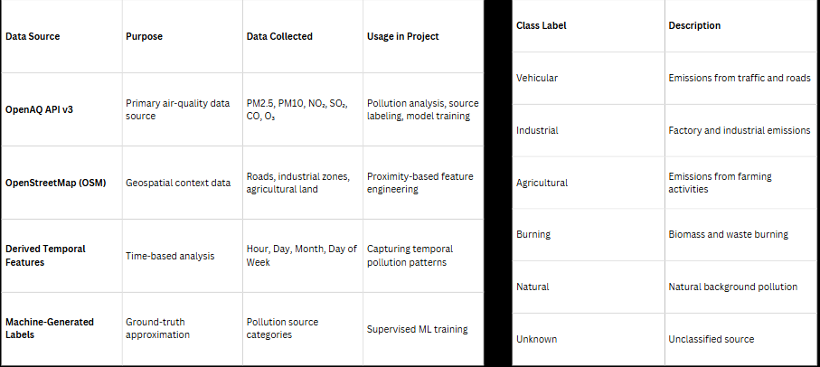
Data Sources
POLLUTION SOURCE CATEGORIES

Slide 9
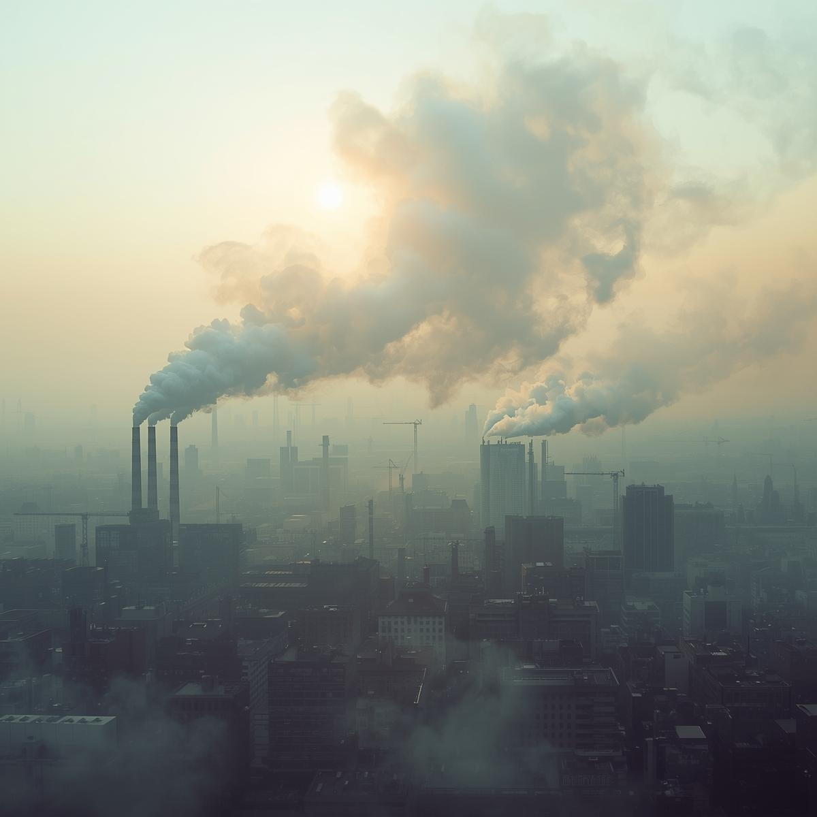
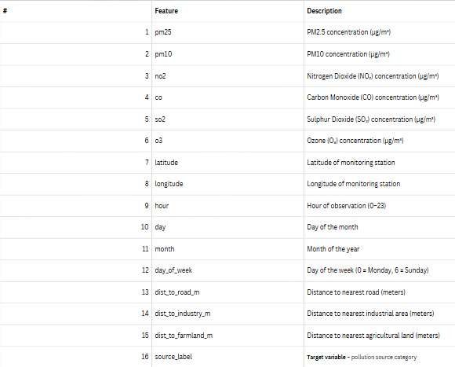
FEATURE ENGINEERING – FINAL FEATURE SET

Slide 10

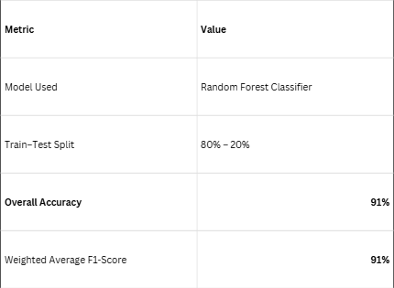
EVALUATION METRICS AND RESULTS

Slide 11
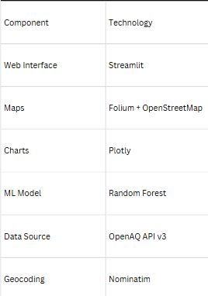
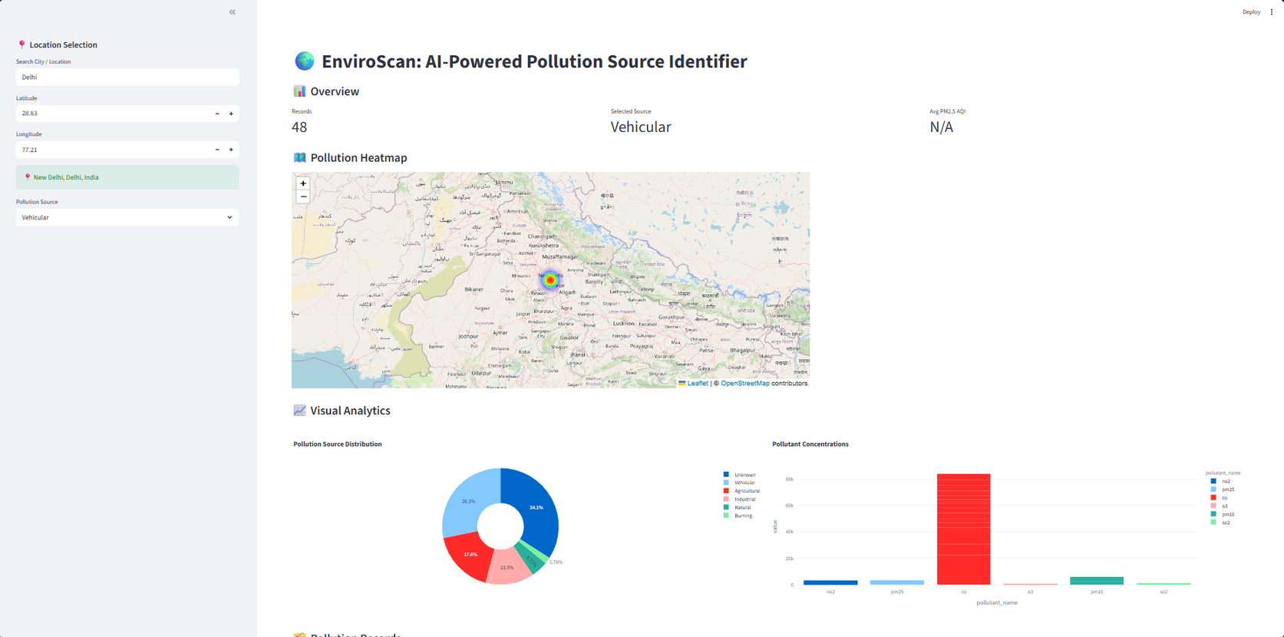
DASHBOARD FEATURES

Slide 12
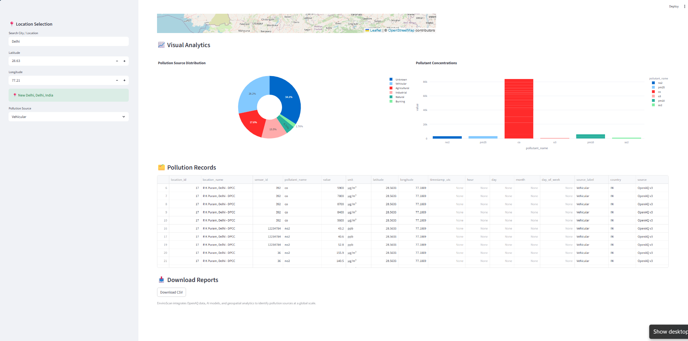

Slide 13
References
OpenAQ Platform – (https://openaq.org)
Scikit-learn Documentation – (https://scikit-learn.org)
Streamlit Documentation – (https://streamlit.io)
OpenStreetMap-(https://www.openstreetmap.org)

Slide 14
Conclusion
AI-based pollution source prediction
91% model accuracy (Random Forest)
Effective use of geospatial features
Interactive real-time dashboard
Practical application in environmental monitoring

Slide 15
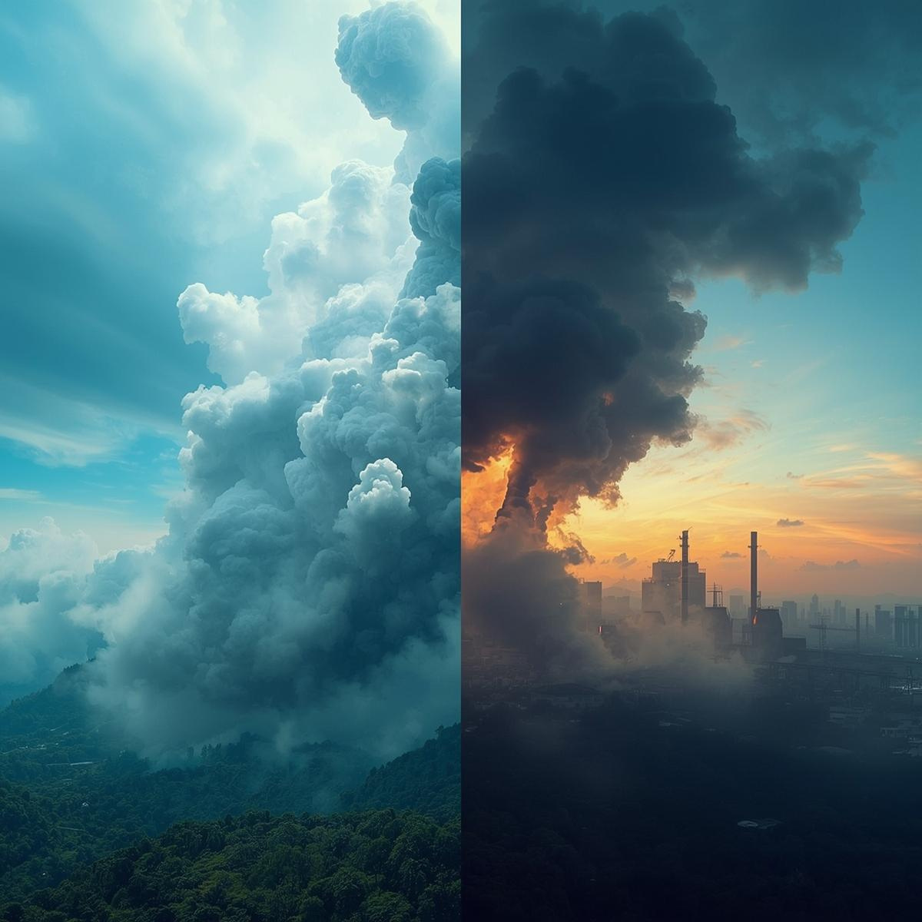
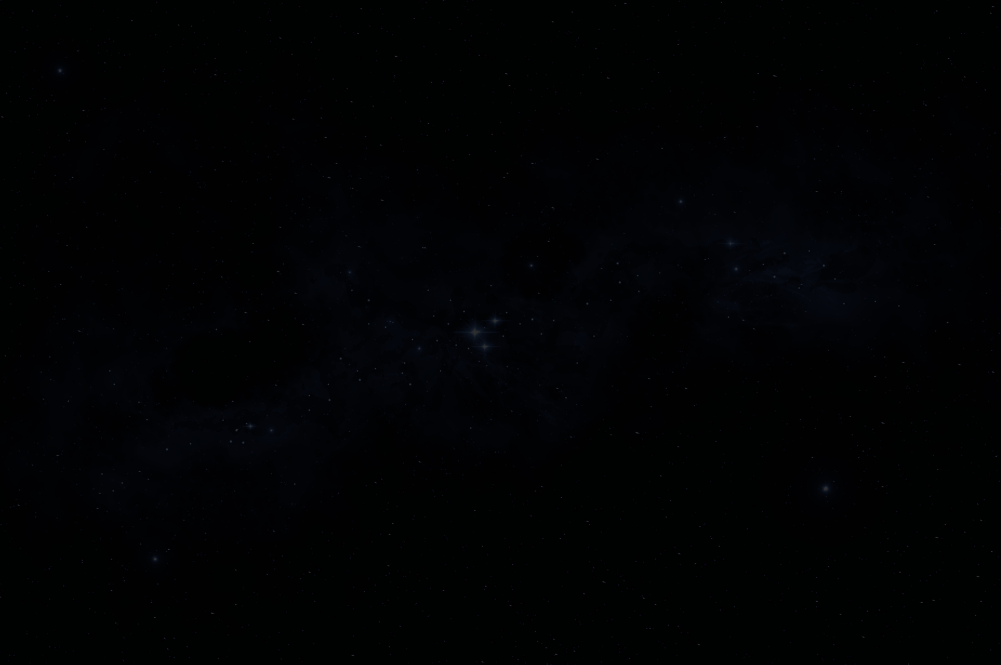

THANK YOU
2025

